Slide 1

Chapter 3 Slides
Java Simple Data Types
PowerPoint Presentation
created by:
Mr. John L. M. Schram
and Mr. Leon Schram

Slide 2
Section 3.2
Declaring
Variables

Slide 3
Java Keywords
• Reserved Words
Part of the Java language
Examples: public, static, void
• Pre-defined Java Identifiers
Defined in Java Libraries
Examples: print & println
• User-defined Identifiers
Examples: shown in this chapter

Slide 4

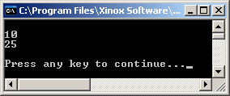
// Java0301.java
// This program demonstrates how to declare integer variables with <int>,
// and it shows how to display the value of a variable with <println>.
public class Java0301
{
public static void main (String args[])
{
int a;
int b;
a = 10;
b = 25;
System.out.println();
System.out.println(a);
System.out.println(b);
System.out.println();
}
}
"a equals 10"
"a becomes 10"
"a stores the value of 10"
a | b
10 | 25

Slide 5
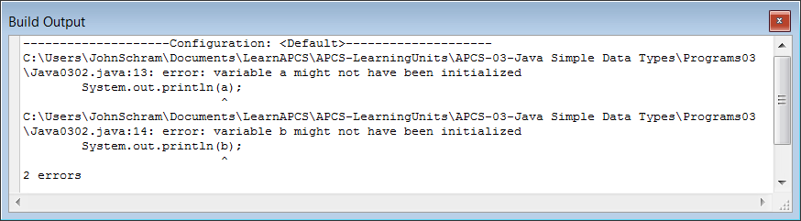
// Java0302.java
// This program is the same as Java0301.java without assigning values
// to the variables. Java does not compile a program that attempts to use
// unassigned "simple" data types.
public class Java0302
{
public static void main (String args[])
{
int a;
int b;
System.out.println(a);
System.out.println(b);
}
}
a | b
? | ?
What does 'a' store?
What does 'b' store?

Slide 6
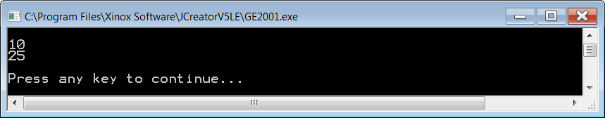
// Java0303.java
// This program demonstrates that it is possible to declare a variable
// identifier and initialize the variable in the same statement.
// It is a good habit to initialize variables where they are declared.
public class Java0303
{
public static void main (String args[])
{
int a = 10;
int b = 25;
System.out.println();
System.out.println(a);
System.out.println(b);
System.out.println();
}
}
a | b
10 | 25

Slide 7

// Java0304.java
// This program combines output of literals and variables.
// "a: " is a string literal, which displays the characters a:
// a is an integer variable, which displays its integer value 10.
public class Java0304
{
public static void main (String args[])
{
int a = 10;
int b = 25;
System.out.println("a: " + a);
System.out.println("b: " + b);
}
}
a | b
10 | 25

Slide 8
Section 3.3
The Integer
Data Types

Slide 9
Java Integer Data Types
Data Type | Bytes used in memory | Minimum Value Maximum Value
byte | 1 | -128 127
short | 2 | -32,768 32,767
int | 4 | -2,147,483,648 2,147,483,647
long | 8 | -9,223,372,036,854,775,808 9,223,372,036,854,775,807

Slide 10
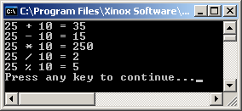
// Java0305.java
// This program demonstrates the five integer operations.
public class Java0305
{
public static void main (String args[])
{
int a = 0;
int b = 25;
int c = 10;
a = b + c; // Addition
System.out.println(b + " + " + c + " = " + a);
a = b - c; // Subtraction
System.out.println(b + " - " + c + " = " + a);
a = b * c; // Multiplication
System.out.println(b + " * " + c + " = " + a);
a = b / c; // Integer Quotient Division
System.out.println(b + " / " + c + " = " + a);
a = b % c; // Integer Remainder Division
System.out.println(b + " % " + c + " = " + a);
}
}

Slide 11
Integer Quotient Division Examples
12 / 1 = 12 12 / 2 = 6 12 / 3 = 4 12 / 4 = 3 12 / 5 = 2 12 / 6 = 2 12 / 7 = 1 | 12 / 8 = 1 12 / 9 = 1 12 / 10 = 1 12 / 11 = 1 12 / 12 = 1 12 / 13 = 0 12 / 0 = undefined

Slide 12
Integer Remainder Division Examples
12 % 1 = 0 12 % 2 = 0 12 % 3 = 0 12 % 4 = 0 12 % 5 = 2 12 % 6 = 0 12 % 7 = 5 | 12 % 8 = 4 12 % 9 = 3 12 % 10 = 2 12 % 11 = 1 12 % 12 = 0 12 % 13 = 12 12 % 0 = undefined

Slide 13
What do the red numbers have in common?
12 % 1 = 0 12 % 2 = 0 12 % 3 = 0 12 % 4 = 0 12 % 5 = 2 12 % 6 = 0 12 % 7 = 5 | 12 % 8 = 4 12 % 9 = 3 12 % 10 = 2 12 % 11 = 1 12 % 12 = 0 12 % 13 = 12 12 % 0 = undefined
They are all factors of 12.

Slide 14
Flashback To Elementary School Long Division
Using / gives you the integer quotient.
4
3)12
12
0
2
5)13
10
3
0
15)12
0
12
0
12)0
0
0
???
0)12
???
???
Using % gives you the integer remainder.

Slide 15
Section 3.4
Real Number
Data Types

Slide 16
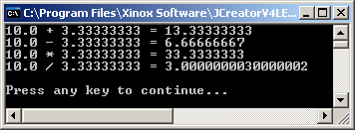
// Java0306.java
// This program demonstrates the double data type which is used for real numbers
// It also demonstrates the four real number operations.
public class Java0306
{
public static void main (String args[])
{
double d1 = 0;
double d2 = 10.0;
double d3 = 3.33333333;
d1 = d2 + d3; // Addition
System.out.println(d2 + " + " + d3 + " = " + d1);
d1 = d2 - d3; // Subtraction
System.out.println(d2 + " - " + d3 + " = " + d1);
d1 = d2 * d3; // Multiplication
System.out.println(d2 + " * " + d3 + " = " + d1);
d1 = d2 / d3; // Real Number Quotient Division
System.out.println(d2 + " / " + d3 + " = " + d1);
System.out.println();
}
}
NOTE: Calculations performed with double
variables are accurate to 15 decimal places.

Slide 17
Java Real Number Data Types/Operations
float 4 bytes
double 8 bytes
Addition: 6.75 + 2.5 = 9.25
Subtraction: 6.75 - 2.5 = 4.25
Multiplication: 6.75 * 2.5 = 16.875
Real # Quotient Division: 6.75 / 2.5 = 2.7

Slide 18
What About Real # Remainder Division?
Java textbooks usually state that remainder or modulus division does not exist for real numbers. Real numbers do not have remainder division in any practical sense. There also is the issue that Java is based on C++, which does not allow remainder division with real number data types. Even though the following examples do not work in C++, they actually do work in Java.
10.0 % 5.0 = 0.0
10.0 % 3.0 = 1.0
3.0 % 10.0 = 3.0
6.75 % 2.5 = 1.75

Slide 19
Section 3.5
Numerical
Representation Limits

Slide 20
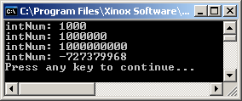
// Java0307.java
// This program demonstrates memory overflow problems.
// Saving memory is important, but too little memory can
// also cause problems.
public class Java0307
{
public static void main (String args[])
{
int intNum = 1000;
System.out.println("intNum: " + intNum);
intNum = intNum * 1000;
System.out.println("intNum: " + intNum);
intNum = intNum * 1000;
System.out.println("intNum: " + intNum);
intNum = intNum * 1000;
System.out.println("intNum: " + intNum);
}
}

Slide 21


The Odometer Analogy in Decimal
+ 0.1 mile =
When many cars reach 100,000 miles
their odometers cease to be accurate.
9 | 9 | 9 | 9 | 9 | 9
0 | 0 | 0 | 0 | 0 | 0

Slide 22
The Odometer Analogy with a short integer
The largest possible short integer value is 32,767 which in binary looks like this:
If we add 1 we get this result:
+ 1 =
32767 + 1 = 32768
0 1 1 1 1 1 1 1 1 1 1 1 1 1 1 1
1 0 0 0 0 0 0 0 0 0 0 0 0 0 0 0

Slide 23
How Positive Numbers Give Negative Results
The first bit in a number is the sign bit
It determines if a number is positive or negative
0 = Positive 1 = Negative
32767 + 1 = -32768
0 1 1 1 1 1 1 1 1 1 1 1 1 1 1 1
1 0 0 0 0 0 0 0 0 0 0 0 0 0 0 0

Slide 24
Memory Overflow Problems
Memory overflow is a situation where the
assigned value of a variable exceeds the
allocated storage space.
The resulting value that is stored will be
inaccurate and can change from positive
to negative or negative to positive.
Avoid memory overflow problems by using a data type that can handle the size of the assigned values.
It is important to save computer memory.
However, do not be so stingy with memory
that overflow problems occur.

Slide 25
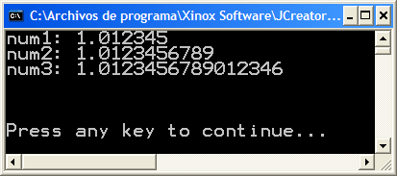
// Java0308.java
// This program shows that there is a memory storage limitation to
// how many digits are stored beyond the decimal point.
public class Java0308
{
public static void main (String args[])
{
double num1 = 1.012345;
double num2 = 1.0123456789;
double num3 = 1.01234567890123456789;
System.out.println("num1: " + num1);
System.out.println("num2: " + num2);
System.out.println("num3: " + num3);
System.out.println("\n\n");
}
}

Slide 26
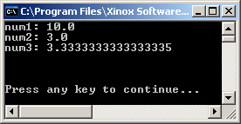
// Java0309.java
// This program demonstrates another error.
// The program output displays a number that is mathematically incorrect.
public class Java0309
{
public static void main (String args[])
{
double num1 = 10.0;
double num2 = 3.0;
double num3 = num1 / num2;
System.out.println("num1: " + num1);
System.out.println("num2: " + num2);
System.out.println("num3: " + num3);
System.out.println("\n\n");
}
}
Rounding Errors
are common with
long decimal #s.

Slide 27
Section 3.6
Arithmetic
Shortcut
Notations

Slide 28
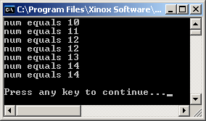
// Java0310.java
// This program shows "unary" arithmetic shortcut notation in Java.
// Note that "postfix" x++ & "prefix" ++x don't always have the same result.
public class Java0310
{
public static void main (String args[])
{
int num = 10;
System.out.println("num equals " + num);
num++;
System.out.println("num equals " + num);
++num;
System.out.println("num equals " + num);
System.out.println("num equals " + num++);
System.out.println("num equals " + num);
System.out.println("num equals " + ++num);
System.out.println("num equals " + num);
System.out.println();
}
}

Slide 29
Java Unary Operators
k++; is the same as: k = k + 1;
++k; is the same as: k = k + 1;
k--; is the same as: k = k - 1;
--k; is the same as: k = k - 1;

Slide 30
Proper Usage of Shortcuts
Proper Usage:
k++;
System.out.println(k);
--k;
System.out.println(k);
Problematic Usage:
System.out.println(k++);
System.out.println(--k);

Slide 31
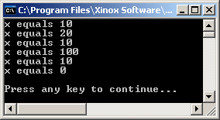
// Java0311.java
// This program shows arithmetic assignment operations in Java.
// x+=10; is the same as x = x + 10;
public class Java0311
{
public static void main (String args[])
{
int x = 10;
System.out.println("x equals " + x);
x += 10;
System.out.println("x equals " + x);
x -= 10;
System.out.println("x equals " + x);
x *= 10;
System.out.println("x equals " + x);
x /= 10;
System.out.println("x equals " + x);
x %= 10;
System.out.println("x equals " + x);
System.out.println();
}
}

Slide 32
Binary Operator Shortcuts
No Shortcut Notation Shortcut Notation
k = k + 5; k += 5;
k = k - 5; k -= 5;
k = k * 5; k *= 5;
k = k / 5; k /= 5;
k = k % 5; k %= 5;

Slide 33
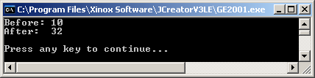
// Java0312.java
// This program demonstrates very bad programming style by
// combining various shortcuts in one statement. It is difficult
// to determine what actually is happening.
public class Java0312
{
public static void main (String args[])
{
int x = 10;
System.out.println("Before: " + x);
x += ++x + x++;
System.out.println("After: " + x);
System.out.println();
}
}
Do not waste any time trying to figure out why the answer is 32.
The point being made here is this code is very confusing and should be avoided.

Slide 34
Shortcut Warning
Do not combine shortcuts
in one program statement!!!
num += ++num + num++;

Slide 35
Section 3.7
The char
& String
Data Types

Slide 36
// Java0313.java
// This program demonstrates the <char> data types.
// It also demonstrates how assignment can be "chained" with
// multiple variables in one statement.
public class Java0313
{
public static void main (String args[])
{
char c1 = 'A';
char c2 = 'B';
char c3 = 'C';
System.out.println("The three characters are: " + c1 + c2 + c3);
c1 = c2 = c3 = 'Q';
System.out.println("The three characters are: " + c1 + c2 + c3);
System.out.println();
}
}

Slide 37
// Java0313.java
// This program demonstrates the <char> data types.
// It also demonstrates how assignment can be "chained" with
// multiple variables in one statement.
public class Java0313
{
public static void main (String args[])
{
char c1 = 'A';
char c2 = 'B';
char c3 = 'C';
System.out.println("The three characters are: " + c1 + c2 + c3);
c1 = c2 = c3 = 'Q';
System.out.println("The three characters are: " + c1 + c2 + c3);
System.out.println();
}
}
c1 | c2 | c3
A | B | C

Slide 38

// Java0313.java
// This program demonstrates the <char> data types.
// It also demonstrates how assignment can be "chained" with
// multiple variables in one statement.
public class Java0313
{
public static void main (String args[])
{
char c1 = 'A';
char c2 = 'B';
char c3 = 'C';
System.out.println("The three characters are: " + c1 + c2 + c3);
c1 = c2 = c3 = 'Q';
System.out.println("The three characters are: " + c1 + c2 + c3);
System.out.println();
}
}
c1 | c2 | c3
A | B | C
c1 | c2 | c3
Q | Q | Q
This is a special shortcut
called “CHAINING.”

Slide 39
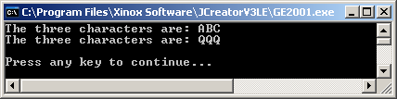
// Java0313.java
// This program demonstrates the <char> data types.
// It also demonstrates how assignment can be "chained" with
// multiple variables in one statement.
public class Java0313
{
public static void main (String args[])
{
char c1 = 'A';
char c2 = 'B';
char c3 = 'C';
System.out.println("The three characters are: " + c1 + c2 + c3);
c1 = c2 = c3 = 'Q';
System.out.println("The three characters are: " + c1 + c2 + c3);
System.out.println();
}
}
c1 | c2 | c3
A | B | C
c1 | c2 | c3
Q | Q | Q

Slide 40
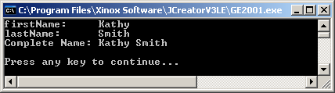
// Java0314.java
// This program demonstrates the <String> data type.
public class Java0314
{
public static void main (String args[])
{
String firstName = "Kathy" ;
String lastName = "Smith";
System.out.println("firstName: " + firstName);
System.out.println("lastName: " + lastName);
System.out.println("Complete Name: " + firstName + " " + lastName);
System.out.println();
}
}
firstName | lastName
Kathy | Smith

Slide 41
Don't Get Confused!
These
may
all
look
the
same…
Value | Data Type
7 | int
7.0 | double
'7' | char
"7" | String
but the
computer
treats
them
differently.

Slide 42
String Concatenation
Concatenation is the appending (or joining) of 2 or more strings.
"Hello" + "World" = "HelloWorld"
"Hello" + " " + "World" = "Hello World"
"100" + "200" = "100200"
The plus operator ( + ) is used both for arithmetic addition and string concatenation. The same operator performs 2 totally different operations. This is called overloading.

Slide 43
Section 3.8
The Boolean
Data Type

Slide 44
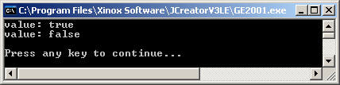
// Java0315.java
// This program demonstrates the <boolean> data type.
// The boolean type can only have two values: true or false.
public class Java0315
{
public static void main (String args[])
{
boolean value = true;
System.out.println("value: " + value);
value = false;
System.out.println("value: " + value);
System.out.println();
}
}
value
true
value
false

Slide 45
AP Exam Alert
The int, double, boolean and String data types will be tested.
The byte, short, long, float and char data types
will NOT be tested.

Slide 46
Section 3.9
Declaring
Constants

Slide 47
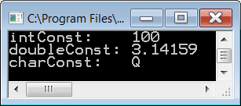
// Java0316.java
// This program demonstrates how to create "constant" identifier values with
// the <final> keyword. Removing the comments from the three assignment
// statements will result in compile errors.
public class Java0316
{
public static void main (String args[])
{
final int intConst = 100;
final double doubleConst = 3.14159;
final char charConst = 'Q';
// intConst++;
// doubleConst = 1234.4321;
// charConst = 'A';
System.out.println("intConst: " + intConst);
System.out.println("doubleConst: " + doubleConst);
System.out.println("charConst: " + charConst);
System.out.println();
}
}
doubleConst
3.14159
intConst
100
charConst
Q

Slide 48
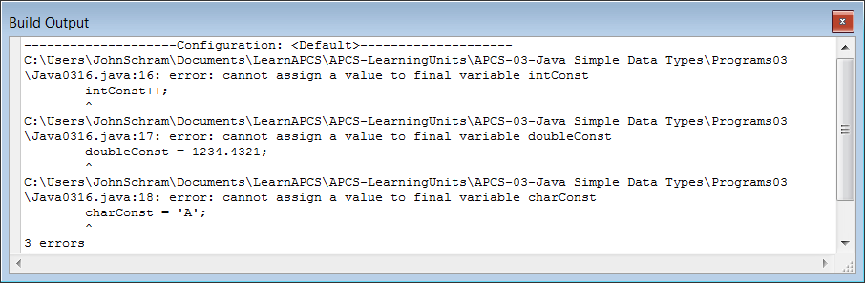
// Java0316.java
// This program demonstrates how to create "constant" identifier values with
// the <final> keyword. Removing the comments from the three assignment
// statements will result in compile errors.
public class Java0316
{
public static void main (String args[])
{
final int intConst = 100;
final double doubleConst = 3.14159;
final char charConst = 'Q';
intConst++;
doubleConst = 1234.4321;
charConst = 'A';
System.out.println("intConst: " + intConst);
System.out.println("doubleConst: " + doubleConst);
System.out.println("charConst: " + charConst);
System.out.println();
}
}
When the comment symbols are removed this is the result.
intConst
100
doubleConst
3.14159
charConst
Q

Slide 49
Section 3.10
Documenting
Your Programs

Slide 50
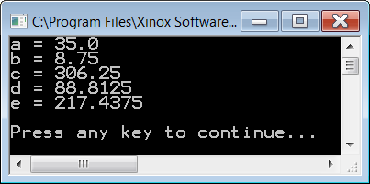
// Java0317.java
// This is an example of a poorly written program with single-letter variables.
// Do you have any idea what this program does?
public class Java0317
{
public static void main (String args[])
{
double a;
double b;
double c;
double d;
double e;
a = 35;
b = 8.75;
c = a * b;
d = c * 0.29;
e = c - d;
System.out.println("a = " + a);
System.out.println("b = " + b);
System.out.println("c = " + c);
System.out.println("d = " + d);
System.out.println("e = " + e);
System.out.println();
}
}

Slide 51
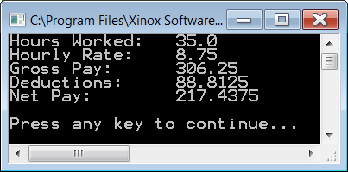
// Java0318.java
// This program does exactly the same thing as the previous program.
// By using self-commenting variables, the program is much easier to read and understand.
public class Java0318
{
public static void main (String args[])
{
double hoursWorked;
double hourlyRate;
double grossPay;
double deductions;
double netPay;
hoursWorked = 35;
hourlyRate = 8.75;
grossPay = hoursWorked * hourlyRate;
deductions = grossPay * 0.29;
netPay = grossPay - deductions;
System.out.println("Hours Worked: " + hoursWorked);
System.out.println("Hourly Rate: " + hourlyRate);
System.out.println("Gross Pay: " + grossPay);
System.out.println("Deductions: " + deductions);
System.out.println("Net Pay: " + netPay);
System.out.println();
}
}

Slide 52
// Java0319.java
// This program adds a multi-line comment at the beginning to help explain the program.
// Several single-line comments are also added to provide more detail for each variable.
/********************************************************************
** **
** Payroll Program **
** Written by Leon Schram 09-09-09 **
** **
** This program takes the hours worked and hourly rate of **
** an employee and computes the gross pay earned. **
** Federal deductions are computed as 29% of gross pay. **
** Finally the take-home pay or net pay is computed by **
** subtraction deductions from gross pay. **
** **
********************************************************************/
public class Java0319
{
public static void main (String args[])
{
double hoursWorked; // hours worked per week
double hourlyRate; // payrate earned per hour
double grossPay; // total earnings in a week
double deductions; // total federal tax deductions
double netPay; // employee take-home pay
hoursWorked = 35;
hourlyRate = 8.75;
The rest of the program is identical to the previous one and is not shown here.

Slide 53
Section 3.11
Mathematical
Precedence

Slide 54
Hidden Math Operations
Mathematics Java Source Code
5XY 5*X*Y
4X + 3Y 4*X + 3*Y
6(A - B) 6*(A - B)
5 5.0/7.0
7
A + B (A + B)/(A - B)
A - B
AB (A * B)/(X * Y)
XY

Slide 55
Mathematical Precedence
Parentheses
Exponents
Multiplication & Division
Addition & Subtraction
PEMDAS
Please Excuse My Dear Aunt Sally.
Painted Elephants March Down Alley Sidewalks.

Slide 56
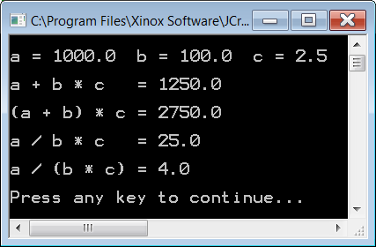
// Java0320.java
// This program demonstrates mathematical precedence in Java operations.
public class Java0320
{
public static void main (String args[])
{
double a, b, c, result;
a = 1000;
b = 100;
c = 2.5;
System.out.println();
System.out.println("a = " + a + " b = " + b + " c = " + c);
result = a + b * c;
System.out.println("\na + b * c = " + result);
result = (a + b) * c;
System.out.println("\n(a + b) * c = " + result);
result = a / b * c;
System.out.println("\na / b * c = " + result);
result = a / (b * c);
System.out.println("\na / (b * c) = " + result);
System.out.println();
}
}

Slide 57
Section 3.12
Type
Casting

Slide 58

// Java0321.java
// This program demonstrates that the intended computation may not be
// performed by Java. The expression on the right side of the assignment
// operator is performed without knowledge of the type on the left side.
public class Java0321
{
public static void main (String args[])
{
int nr1 = 1000;
int nr2 = 3000;
int nr3 = 6000;
double mean;
mean = (nr1 + nr2 + nr3) / 3;
System.out.println("The mean equals: " + mean);
System.out.println();
}
}
Why is
the answer an
integer?

Slide 59
// Java0321.java
// This program demonstrates that the intended computation may not be
// performed by Java. The expression on the right side of the assignment
// operator is performed without knowledge of the type on the left side.
public class Java0321
{
public static void main (String args[])
{
int nr1 = 1000;
int nr2 = 3000;
int nr3 = 6000;
double mean;
mean = (nr1 + nr2 + nr3) / 3;
System.out.println("The mean equals: " + mean);
System.out.println();
}
}
The sum of 3 integers is an integer.

Slide 60
// Java0321.java
// This program demonstrates that the intended computation may not be
// performed by Java. The expression on the right side of the assignment
// operator is performed without knowledge of the type on the left side.
public class Java0321
{
public static void main (String args[])
{
int nr1 = 1000;
int nr2 = 3000;
int nr3 = 6000;
double mean;
mean = (nr1 + nr2 + nr3) / 3;
System.out.println("The mean equals: " + mean);
System.out.println();
}
}
When an integer is divided by another integer, you get integer quotient division.

Slide 61
// Java0321.java
// This program demonstrates that the intended computation may not be
// performed by Java. The expression on the right side of the assignment
// operator is performed without knowledge of the type on the left side.
public class Java0321
{
public static void main (String args[])
{
int nr1 = 1000;
int nr2 = 3000;
int nr3 = 6000;
double mean;
mean = (nr1 + nr2 + nr3) / 3;
System.out.println("The mean equals: " + mean);
System.out.println();
}
}
The fact that mean is a double has absolutely NO effect on the calculations which take place on the other side of the = sign.

Slide 62

// Java0322.java
// This program corrects the logic error of Java0321.java.
// Type casting is used to "force" real number quotient division.
public class Java0322
{
public static void main (String args[])
{
int nr1 = 1000;
int nr2 = 3000;
int nr3 = 6000;
double mean;
mean = (double) (nr1 + nr2 + nr3) / 3;
System.out.println("The mean equals: " + mean);
System.out.println();
}
}

Slide 63
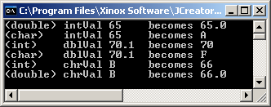
// Java0323.java
// This program demonstrates
// "type casting" between
// different data types.
public class Java0323
{
public static void main (String args[])
{
int intVal = 65;
double dblVal = 70.1;
char chrVal = 'B';
System.out.println("(double) intVal 65 becomes " + (double) intVal);
System.out.println("(char) intVal 65 becomes " + (char) intVal);
System.out.println("(int) dblVal 70.1 becomes " + (int) dblVal);
System.out.println("(char) dblVal 70.1 becomes " + (char) dblVal);
System.out.println("(int) chrVal B becomes " + (int) chrVal);
System.out.println("(double) chrVal B becomes " + (double) chrVal);
System.out.println();
}
}

Slide 64
Section 3.13
Intro to the
GridWorld Case Study

Slide 65
Case Study Styles
Bottom-Up Style This style starts with a small, minimal information program and slowly from the simplest start, works step-by-step up to a completely functional program.
Top-Down Style This starts with a completely functional program and slowly breaks this large program down into smaller, easier to comprehend segments.

Slide 66
Using the GridWorld Case Study
Dr. Chris Nevison's Quote Do not use computer science to teach the GridWorld Case Study; use the GridWorld Case Study to teach computer science.

Slide 67
GridWorld Case Study
The GridWorld Case Study is developed by the College Board in coordination with ETS and the AP Computer Science Test Development Committee. The program's primary creator and copyrighter is Horstmann, of San Jose State University.
Please note that the inclusion of any GridWorld references and GridWorld examples in this textbook do not imply any type of endorsements of the Exposure Java textbook or its curriculum by the College Board or Cay Horstmann.

Slide 68
AP Exam Alert
The GridWorld Case Study is covered on the AP Computer Science Exam.

Slide 69
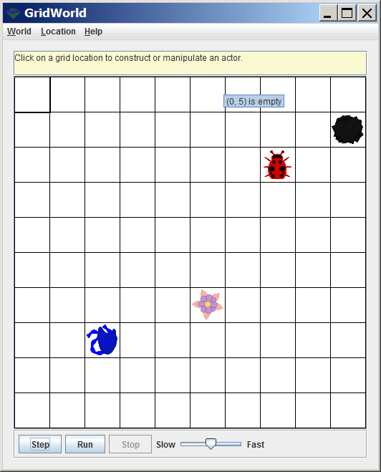
GridWorld Case Study Sample Initial Output

Slide 70
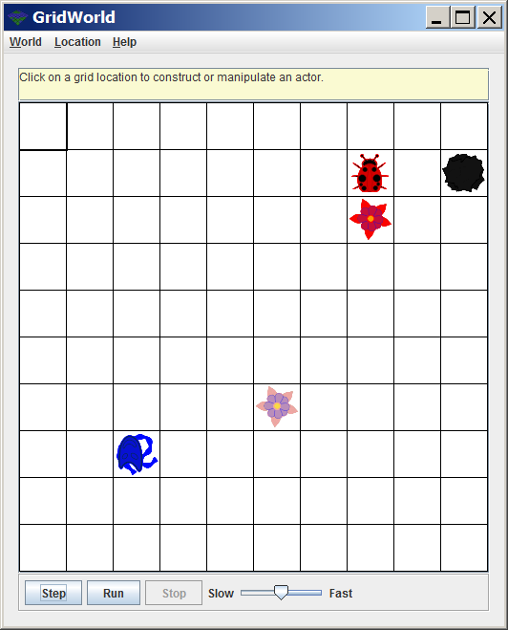
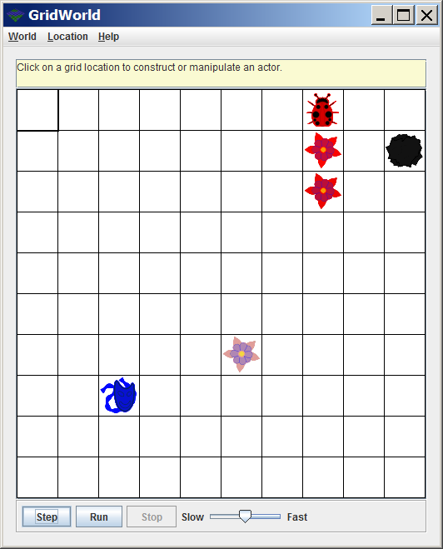
[Step] Click 1 [Step] Click 2

Slide 71
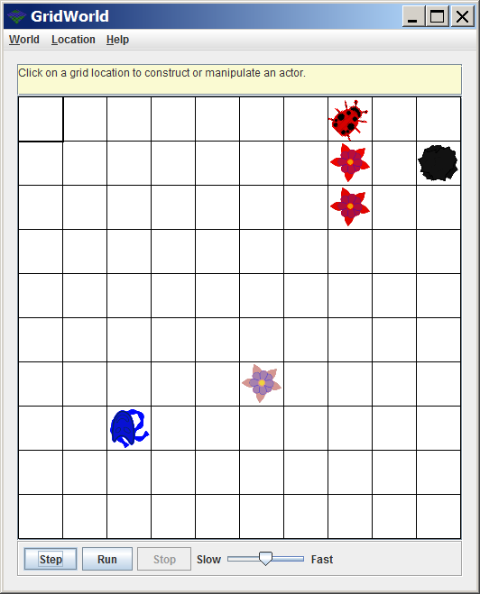
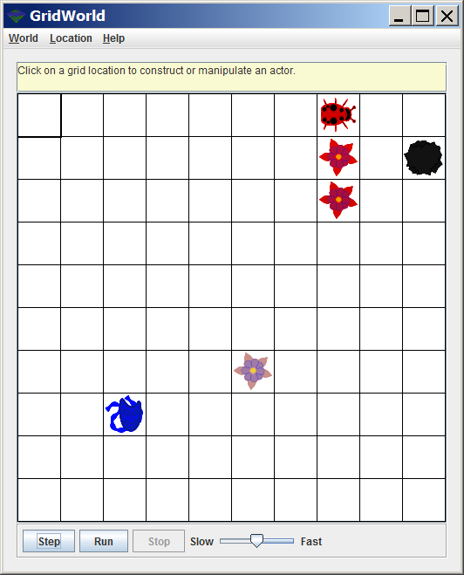
[Step] Click 3 [Step] Click 4

Slide 72
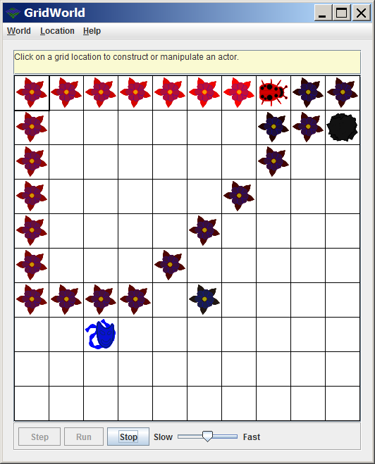
When [Run] is clicked, it is like you are clicking [Step] continuously.

Slide 73
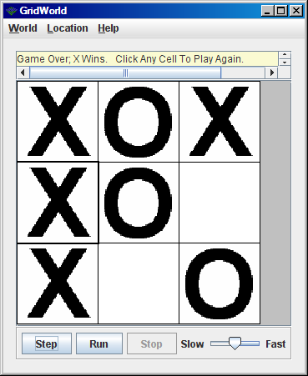
NOTE: GridWorld is not just limited to Actors, Flowers, Rocks and Bugs.

Slide 74
Section 3.14
Compiling and Running
a GridWorld Program

Slide 75
GridWorld Case Study Files
The GridWorld Case Study is an example of a large program with many files that uses a project manager. The CollegeBoard provides the necessary files and your computer science teacher will indicate where on the computer the GWCS files can be found. In the case of the GWCS the minimal files that are necessary to compile and run any GridWorld program are compressed in a special file called gridworld.jar.

Slide 76
Information Hiding
Information Hiding is a computer science tool that involves using program features without the knowledge of how the program features are implemented.
Example:
You do not need to know how to build a car in order to drive one.

Slide 77
Lab Experiment 0324
Lab Experiments and Lab Assignments are different. In a Lab Experiment you follow the steps provided in the textbook along with the teacher's instruction to observe and learn from a guided experiment. There is no grade earned for completing this experiment.

Slide 78
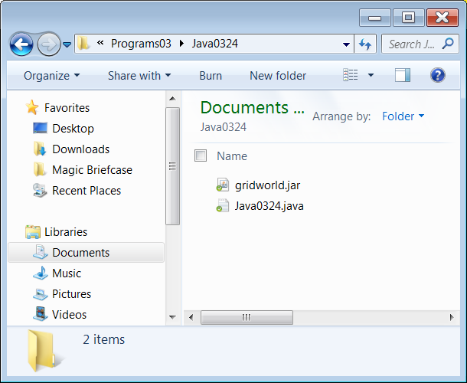
Step 1 Investigate Folder Java0324

Slide 79
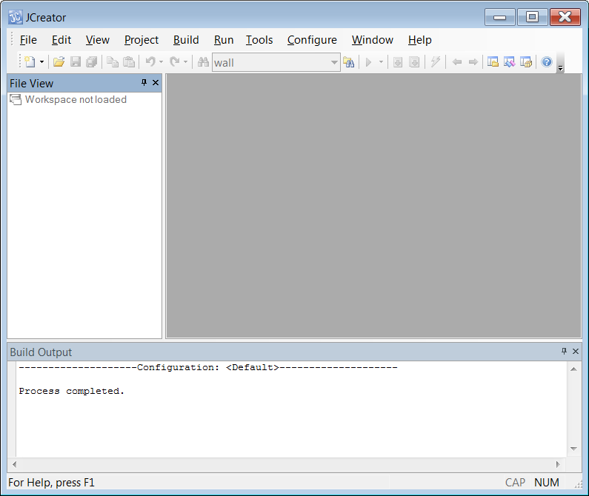
Step 2 Start JCreator
If you do not have the window shown on the left, click View and select File View.

Slide 80
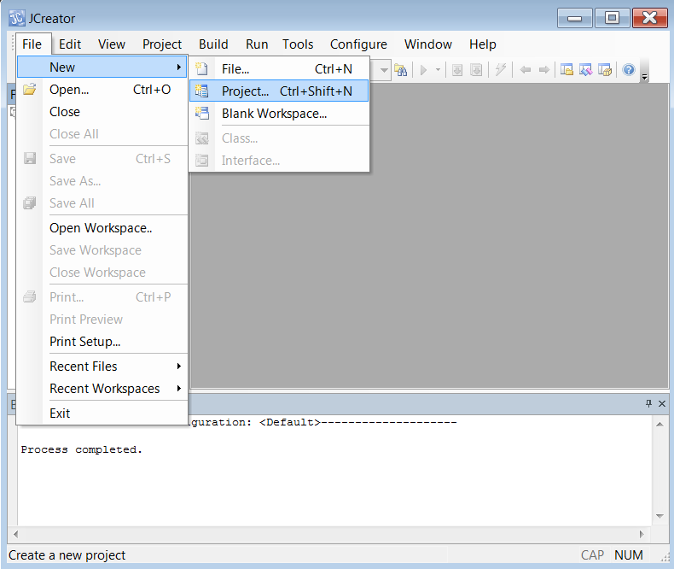
Step 3A Click File – New – Project

Slide 81
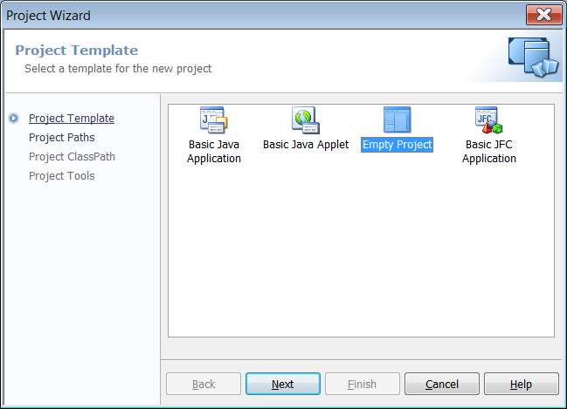
Step 3B Click Empty Project & Next.

Slide 82
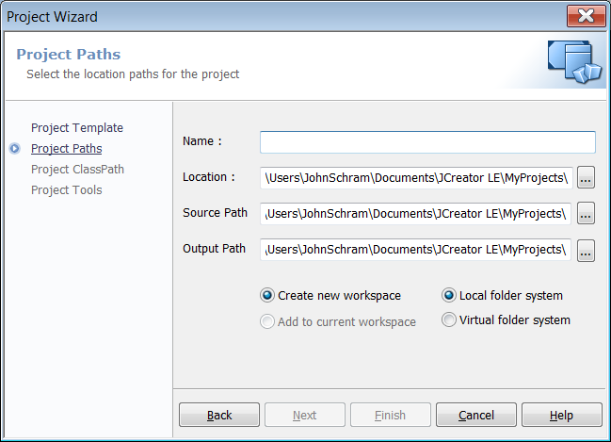
Step 3C Click This Button.

Slide 83
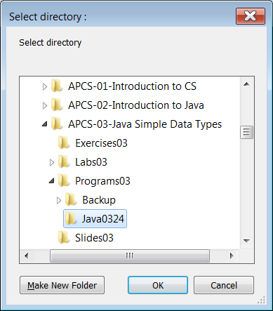
Step 3D Browse to Java0324
and
click
OK.

Slide 84
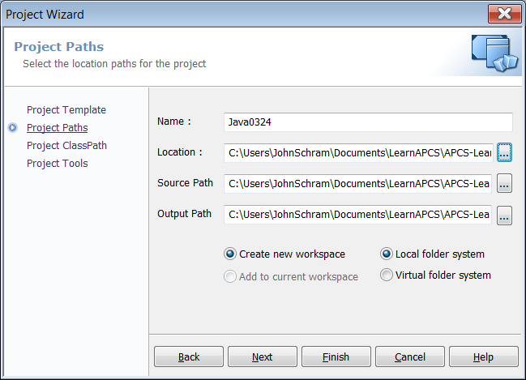
Step 3E Click Finish Twice.

Slide 85
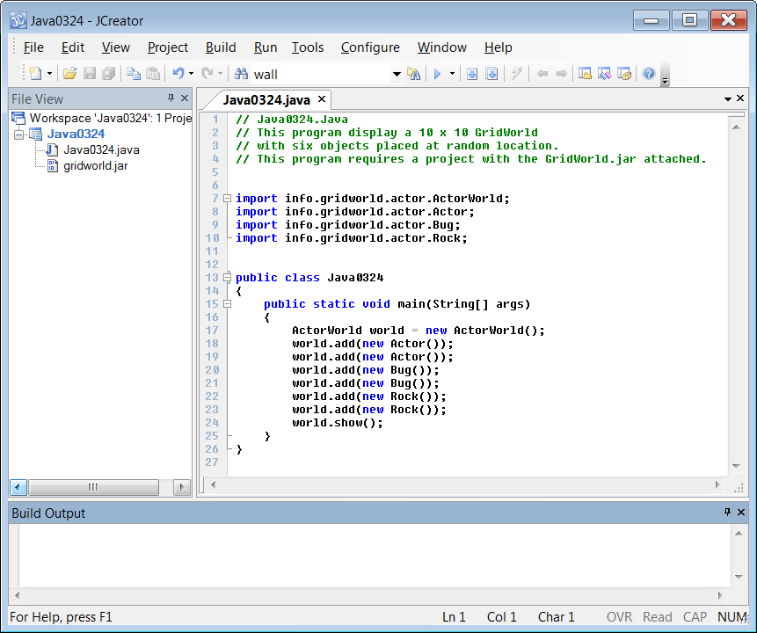
Step 4A Click the Build Project Icon

Slide 86
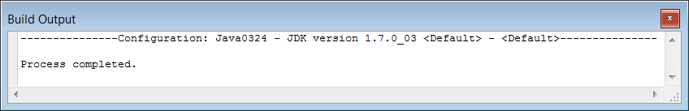
Step 4B If everything was done properly, you will see this in the Build Output window.

Slide 87
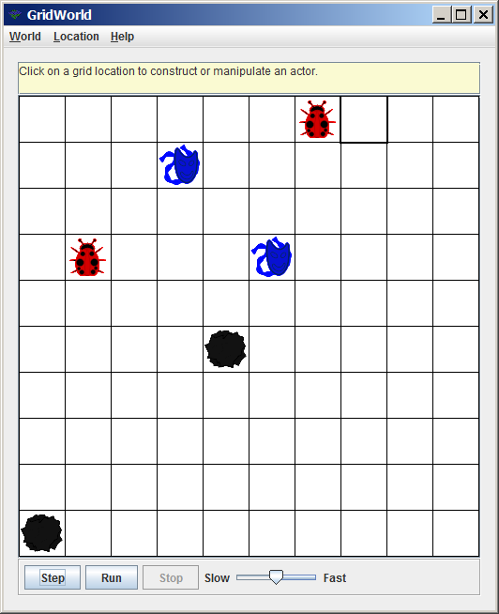
Step 4C Click the Run Project Icon

Slide 88
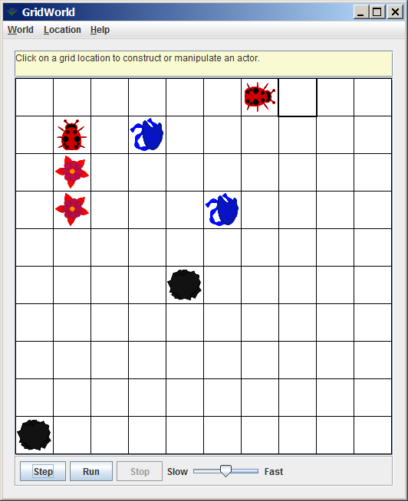
Step 5A Click the Step Button Twice.

Slide 89
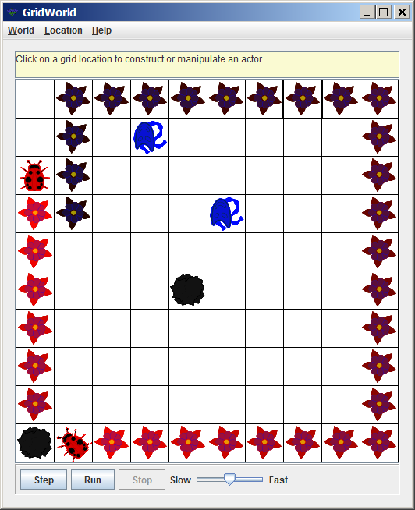
Step 5B Click Run & Adjust the Speed

